Slide 1
MIPS 3
Julia abbott
Jude battista

Slide 2
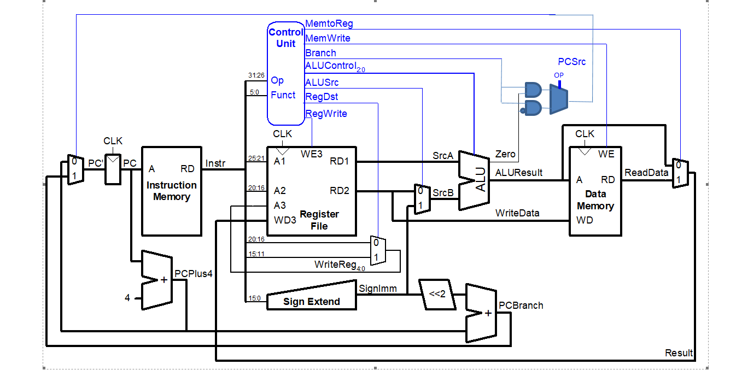
Changes made

Slide 3
Mips test program
addi $4, $0, 1 # mov 1 into $4
addi $5, $0, 1 # mov 1 into $5
bne $4, $5, end # should do nothing since $4 and $5 are equal
addi $5, $5, '1' # add one to $5, making it not equal to $4
bne $4, $5, testXori # should branch to the testXori section, skippingthe jump to end
j end # skip the testXori section
testXori:
addi $4, $0, 3 # Set $4 to three
xori $5, $4, 6 # Do an xor with $4 = 3 and 6, should be 5 (...0011 XOR ...0110 = 0101 = 5)
end:

Slide 4
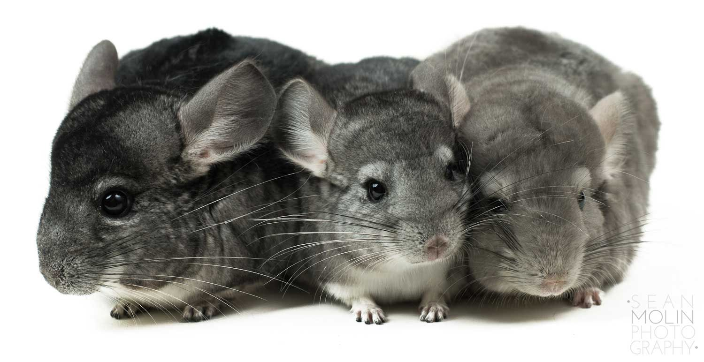

Slide 5
Vhdl chagnes
Imem1
signal mem: ramtype := InitRamFromFile("memfile_3.dat");
Md:maindec
when "001110" => controls <= "101000011"; --XORI
when "000101" => controls <= "0X010X001"; -- BNE
Ad:aludec
when "10" => alucontrol <= "011"; --xori
Mainalu:alu
a xor b when "11",
Cont: controller(struct)
pcsrc <= branch and not zero when op = "000101" else branch and zero;

Slide 6
process

Slide 7
result

